Slide 1
Generic Hours of Service
How it works: automatic driver-hours tracking in On-Road IoT

Slide 2
What Generic HOS gives you
How it works at a glance
Setting up rulesets and drivers
Viewing your data in On-Road IoT
Reporting and integration

Slide 3



What Generic HOS gives you
A simple, automatic way to track driver hours against your own health & safety rules.
Automatic tracking
Built around your policy
No extra hardware
Driver hours are calculated automatically from vehicle activity — no manual logbooks or paperwork.
Limits and rest rules are defined by your organisation, not a fixed regulatory standard.
Runs on the vehicle's existing on-board computer — no additional in-cab device needed.

Slide 4



How it works at a glance
Vehicle activity
Server-side calculation
Visibility & action
The on-board computer records trip and sub-trip start and end events as the vehicle moves and stops.
Events are sent to the server, which works out each driver's Driving and Not-Driving hours against their ruleset.
Results appear in On-Road IoT and Insights reports, and can flow to other systems via Unity Integrate.

Slide 5
Setting up GHOS
Rulesets, configuration and drivers

Slide 6
Rulesets: your hours, your rules
A ruleset is the set of hour limits each driver is measured against.
What a ruleset does
Unique to your organisation
Defines driving-hour limits and rest requirements. Each driver is assigned one, and the system calculates available hours and flags violations against it.
Limits, thresholds and work-state labels are configured per customer to match your own health & safety policy.

Slide 7



Getting set up
Three steps to get Generic HOS running.
1. Enable HOS
2. Configure the OBC
3. Add HOS drivers
Activate Hours of Service for your organisation in Database Administration.
Set arming and standing delays so trips and sub-trips are captured accurately.
Designate drivers and assign each a ruleset.

Slide 8
Hours are calculated automatically
Work state follows the vehicle: a trip start means Driving; a trip end means Not Driving.
The server continuously calculates used and available hours against each driver's ruleset.
If the OBC loses signal, the last status is held as assumed data (shown in blue) and corrected automatically when it reconnects.
No driver input required.

Slide 9
Viewing your data
On-Road IoT — HOS Overview, Timeline and Log Viewer

Slide 10
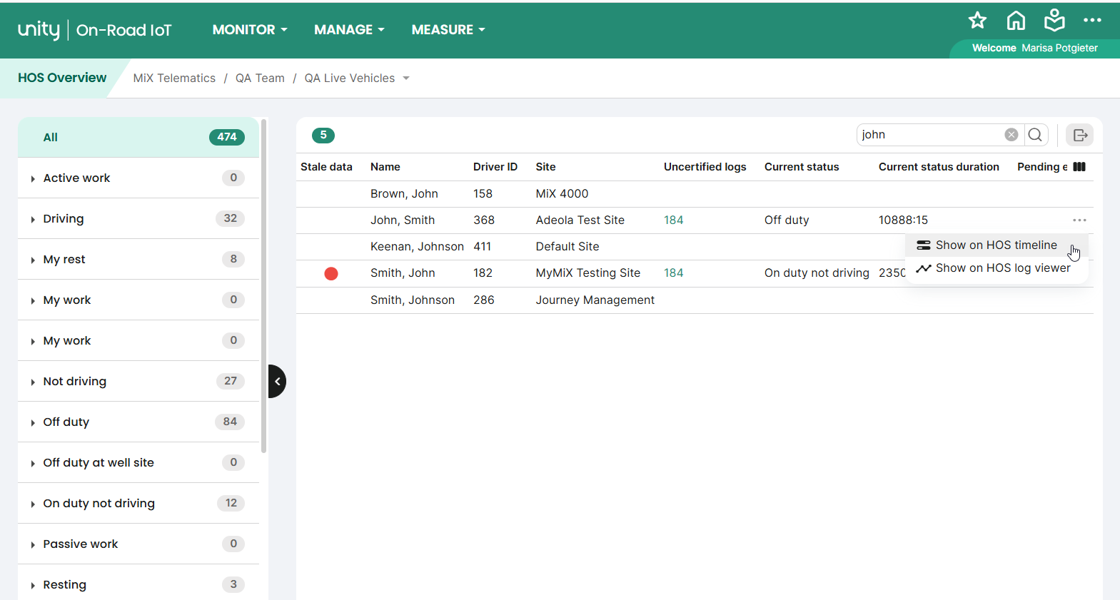
HOS Overview
A fleet-wide list of all HOS drivers (Monitor > Hours of Service > HOS overview).
Filter, sort and search across all drivers.
Use the In violation filter to see only drivers currently over their limits.
Jump to a driver's timeline or log, or export the list to Excel.

Slide 11
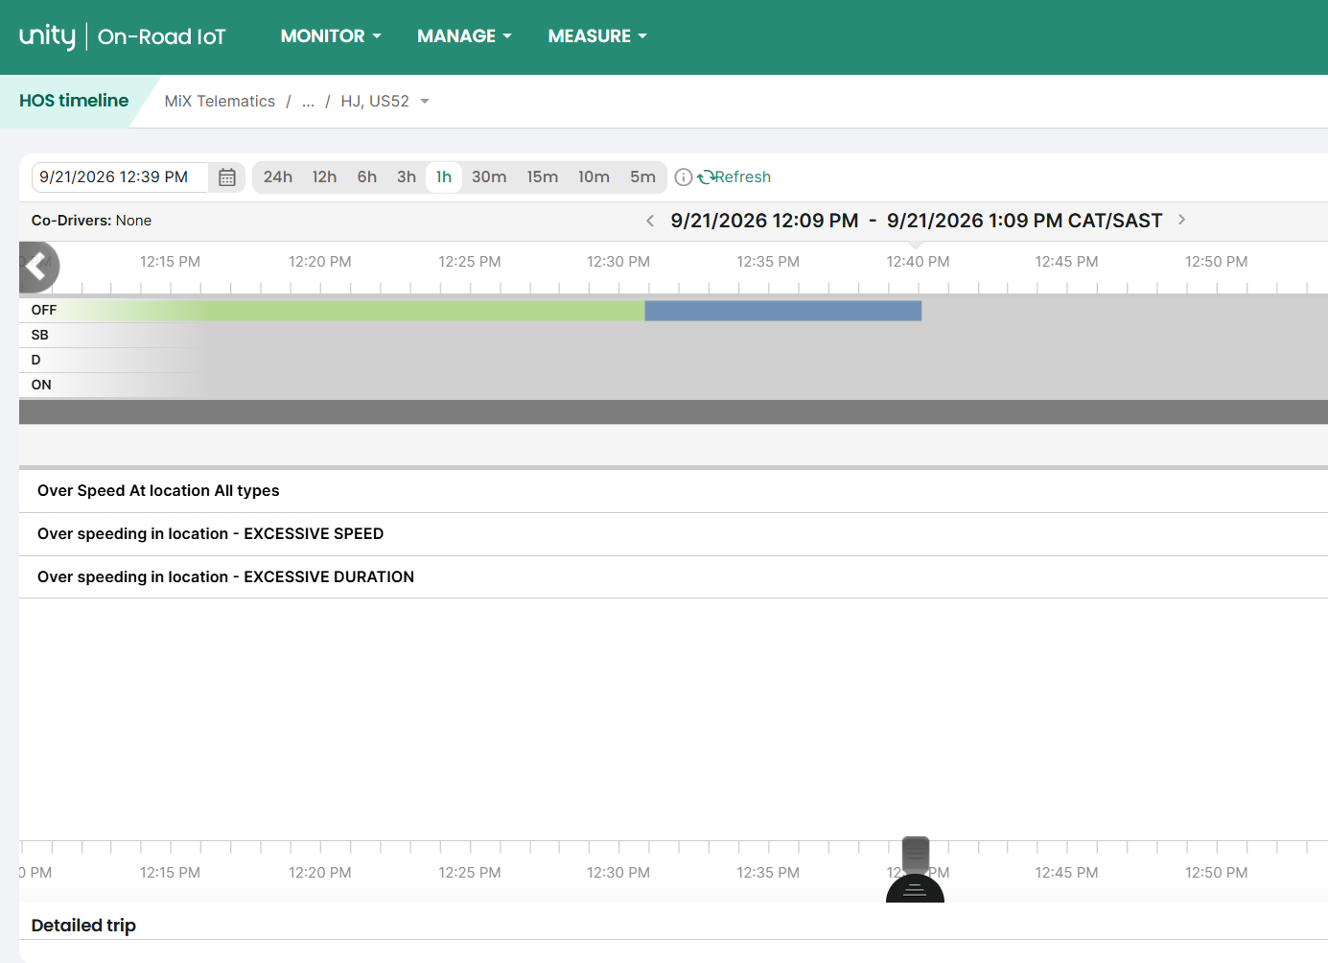
HOS Timeline
An interactive 24-hour view of one driver's activity, built from trip and sub-trip events.
Driving and Not-Driving periods are colour-coded.
Drag the query line for detail at any moment; zoom from 24 hours down to 5 minutes.
Drag to select a period to view or export trip detail.

Slide 12
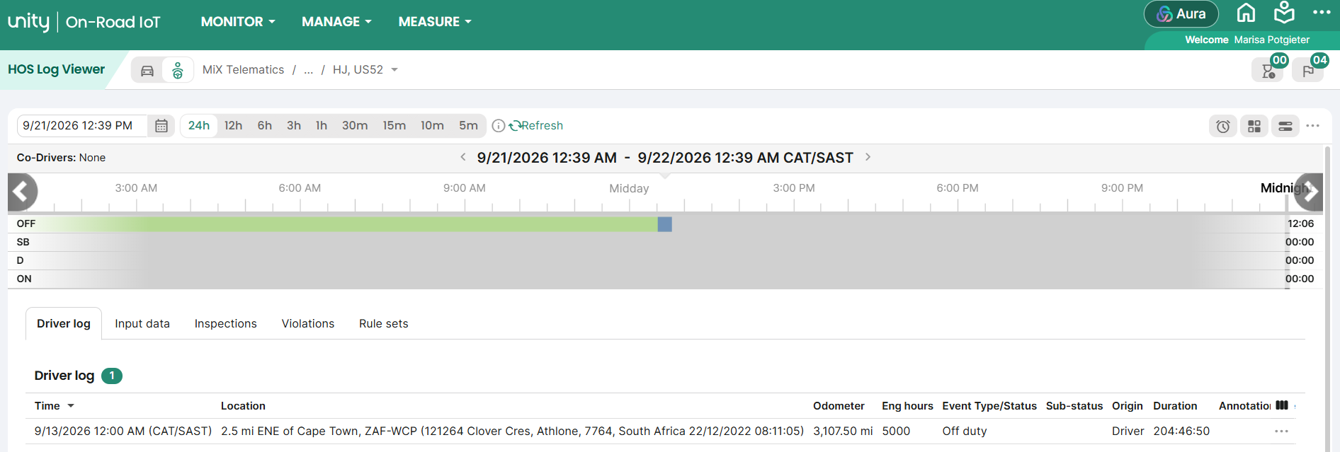
Log Viewer
A per-driver log combining the activity timeline with a detail panel (Monitor > Hours of Service > Log Viewer).
Review violations against the driver's ruleset.
Jump to the start of any day for a full daily picture.

Slide 13



Staying ahead of violations
Spot and act on hour breaches as they happen.
Violations dashboard
In-violation quick view
HOS notifications
See the share of drivers with and without violations, by site and driver, over your chosen period.
Filter the HOS Overview to show only drivers currently in violation.
Send automatic email or SMS alerts to supervisors when a driver breaches their hour rules.

Slide 14




Reporting in Insights
HOS reports in the Insights suite: Measure > Insights > Reports > Hours of Service.
Hours of Service
Available Hours
HOS Violations
Violation Summaries
Time in each work state — Driving, active and passive work, resting — by day, week and month.
Which drivers still have driving or non-driving hours, based on their ruleset.
When and how drivers breached their ruleset, with full violation detail.
Violation counts rolled up per driver, per site and across the organisation.

Slide 15




Integrating HOS data with Unity Integrate
HOS data is available through Unity Integrate, Powerfleet's REST API, to feed third-party systems.
API documentation: integrate.us.mixtelematics.com · Getting started: Unity Integrate on Powerfleet Knowledge
HOS events
Violations
Available hours
Secure access
Driving and not-driving events, raw or summarised, retrievable incrementally.
Ruleset violations for a driver or group over a date range.
Remaining hours for a driver or group.
Access via a Client ID and secret, issued on request.

