Slide 1
SERVER-SIDE EVENTS
Feature information

Slide 2

PROJECT VISION
Server-Side Events allow the generation of location based & movement events server-side through the monitoring of the live AVLs and passive data downloads against the server-side event rules for an organization.

Slide 3
WHO IS IT FOR?
Essentially this is for all Customers (excl.TABS)
With the added benefit that it allows location based event monitoring to Customers who are using OBC with no on board location storage and to
Customers whose locations exceed the storage capacity of the OBC and real-time in-cab feedback is not required.

Slide 4
SOLUTION OVERVIEW
Each position which is received by the server is processed through a new Server-Side Event Engine.
Where a particular Server-Side Event rule is found to be true e.g. asset is in a location, a Server-Side Event is raised.
A new event type “Server-Side” has been created to allow these events to be distinguished in the DynaMiX system.
These Server-Side Events behave just like a normal event within MiX Fleet Manager and can be seen actively in the Info Hub, Live Tracking and in Notifications (email/SMS), or retrospectively in Historical Tracking, MiX Insight Reports and MiX Insight Agility. ***Certain unit type dependencies exist and is explained on slide 12.
Notifications can also be created from Server-Side Events in the normal manner except for “Distance in location” an “Location entry and exit” rule for FM units it cannot. MiX units can have notifications for these two events.

Slide 5
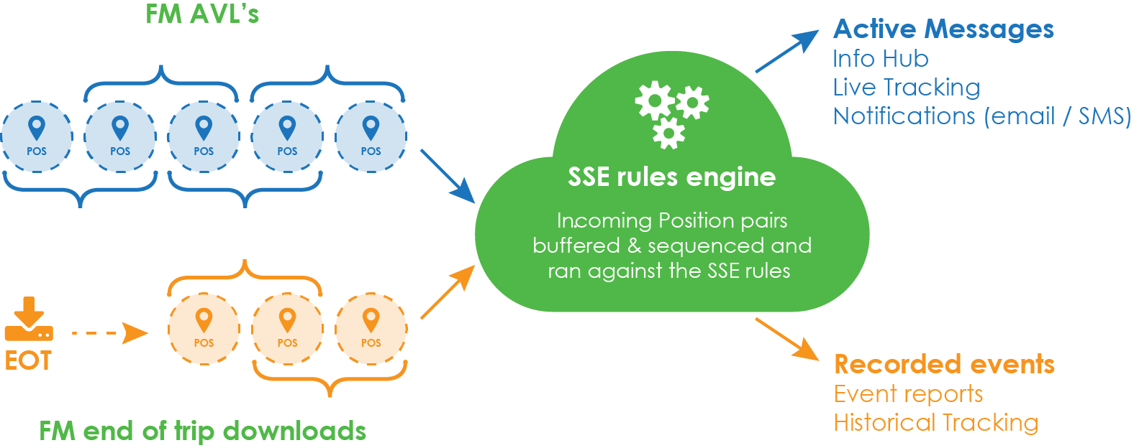
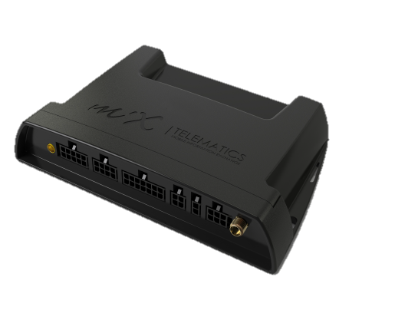
WHAT HAPPENS? (FM UNITS)

Slide 6
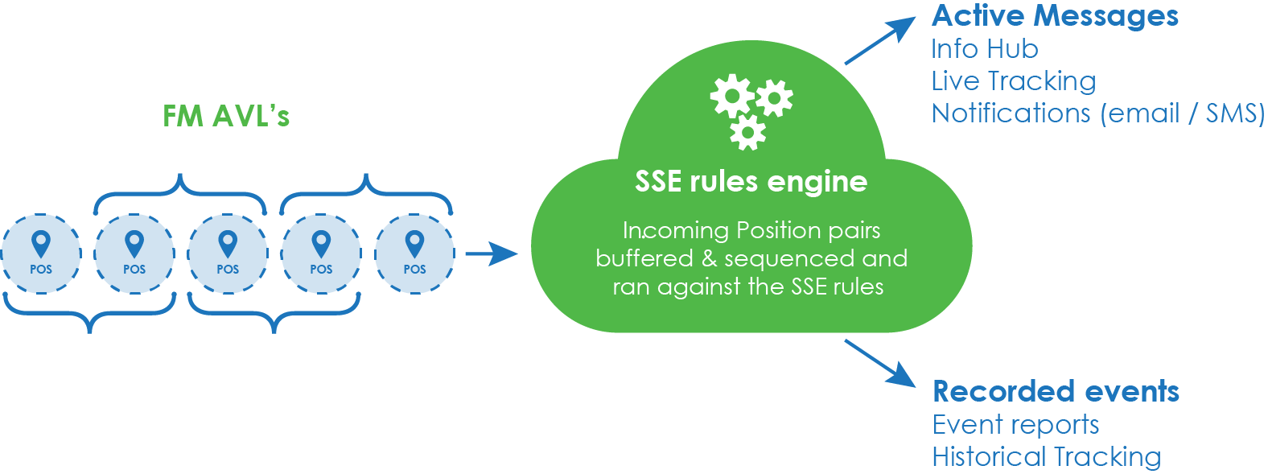
WHAT HAPPENS? (MiX2000/4000/6000 UNITS)

Slide 7
WHAT NEEDS TO BE IN PLACE?
1. Lightning: Positions
SSE engine is fed by positions from the Lightning position store
SSE engine uses locations stored in the Lightning location store for location based events
2. Lightning: Locations
3. DynaMiX Notification Module
Notifications can be created via the DynaMIX Notifications module
User permissions are required to see the Server-side event module
4. Server-side Events permissions

Slide 8
WHAT IS THE USE CASE BOUNDARIES?
Where speed limit data is stored on the on board computer over speeding events can be generated by the on-board computer IN REAL TIME.
These real time events can be used to alert the driver in cab of the violation immediately.
These can be detailed events with accurate durations available for event and scoring reporting.
HOWEVER - Events generated on the server cannot be used to alert drivers immediately.
Events generated on the server are limited to the resolution of the AVL frequency which is defined in the config.
Users with site level access cannot create or edit server-side events just as the case with other events in our system.

Slide 9
WHAT IS THE USE CASE BOUNDARIES?
Regarding the Distance in Location Event - Because we do not have the odometer in the AVLs in general, the distance is calculated based on passive positions only. This event is therefore viewable in historical tracking, timeline and reports for FM’s and MiX units and NOT in live tracking, info hub or notifications for FM units. It should be noted to users that this method also makes use of a straight line calculation (as the crow flies) between points and might not provide 100% exact distance if the road within the location is full of turns and curves. In general distance should be seen as an approximate. See slide 20 for graphical explanation.

Slide 10
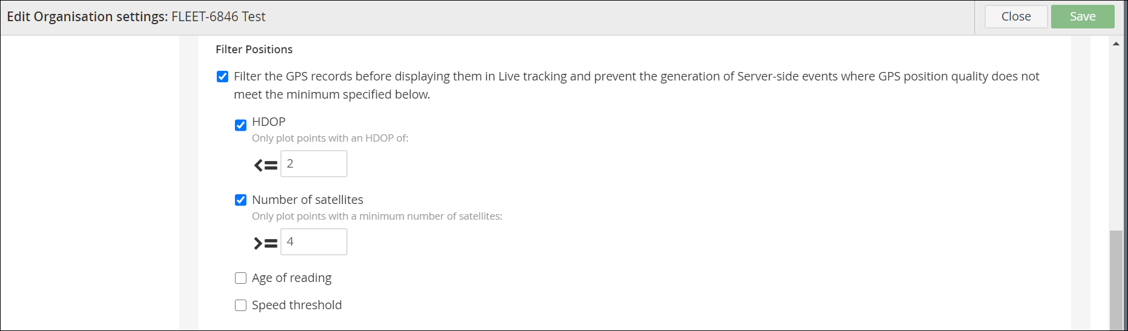
WHAT IS THE USE CASE BOUNDARIES?
In Organization settings on the Tracking options tab, certain GPS filters can be applied to a database which will then hide certain AVL’s in Live Tracking and prevent the generation of server-side events where the GPS position quality does not meet the minimum specified. This needs to be taken into consideration when looking at positions in locations on historical tracking as some of the AVL’s will not meet the filter requirements and not be used to trigger the rule for the specific server-side event.

Slide 11
FM vs MIX2000/4000/6000
Difference between active and passive data? If a server-side rule is using passive or active data it could exclude certain unit types to manifest in certain features like Live Tracking. See below:
  FM’s have active and passive data streams. Active is displayed in Live Tracking, Notifications and Info Hub and passive in Historical Tracking, Reports and Time line.
  MiX units everything comes in active and is displayed as active in Live Tracking, Notifications and Info Hub and as passive in Historical Tracking, Reports and Time line.
  Active data is seen in Live Tracking, Notifications and Info Hub
  Passive data is seen in Historical Tracking, Reports and Time line
  So if a rule uses passive data in the calculation it means that for FM’s you will not have Live Tracking, Notifications or Info Hub AND if a rule uses active data in the calculation it means for FM’s you will not have Historical Tracking, Reports or Time line.
  Because MiX units are set-up differently they will always have everything, ie Live and Historical Tracking, Reports, Notifications, Info Hub and Time Line.

Slide 12
SSE TYPES & RETURNED VALUES
The following events are available by default once SSE has been enabled on an organization:
TYPE | RETURNED VALUE
Duration at location | Location Name **note this is not actual duration at the location, but when for example duration of “x” minutes has been exceeded this event becomes true.
Distance in location | Location Name, distance and duration. See more on slide 23
Location entry/exit | Location Name
Location started/stopped | Location Name
Event at location | Location Name and on board event name
Movement alert | None
Over-speeding in location | Location Name & additional info like Speed Limit, Speed Value, Duration depending on where in the system the event is viewed
Location entry and exit | Location Name, max speed, duration. See more on slide 25

Slide 13
SSE TYPES & ACTIVE vs PASSIVE DATA
SSE TYPE | UNIT TYPE specifications
Duration at location | Active and passive
Distance in location | Distance and duration is calculated on passive positions for FM’s and active positions for MiX units, therefore not available in Live Tracking, Info Hub or Notifications for FM’s but is available for MiX units.
Location entry/exit | Active and passive
Location started/stopped | Active and passive
Event at location | Active only however in backend it is forced as a significant event so it is visible in reports, historical tracking and timeline for FM’s as well.
Movement alert | Active and passive
Over-speeding in location | Active and passive
Location entry and exit | Does not calculate distance, calculates max speed and provides duration. Calculated on passive positions for FM and active positions for MiX units, therefore not available in Live Tracking, Info Hub or Notifications for FM’s but is available for MiX units.

Slide 14
SSE TYPES & UNIT TYPES
SSE TYPE | UNIT TYPE supported
Duration at location | FM, MIX2000/4000/6000
Distance in location | FM, MIX2000/4000/6000
Location entry/exit | FM, MIX2000/4000/6000
Location started/stopped | FM, MIX2000/4000/6000
Event at location | FM, MIX2000/4000/6000
Movement alert | FM, MIX2000/4000/6000
Over-speeding in location | FM, MIX2000/4000/6000
Location entry and exit | FM, MIX2000/4000/6000
Due to how certain unit types determine trip status, they will not be supported for SSE.
VT/AT – not supported
Phone as OBC – not supported
Remora : For example the duration component can't work with Remora and you will only get the notification.

Slide 15
RULES
Important Notes
SSE events are not part of the asset configuration and so do not need to be added to event templates.
SSE events are not visible in Config Admin.
MiX units - The definition of “in trip” is not based on a FM trips as defined in the config. Find out how it is flagged as in-trip??
FM’s (passive) The definition of “in trip” is based on a FM trips as defined in the config.
FM’s (active)
    In trip = Where speed > 5 km/h and distance travelled is greater than 25m.
    Out of trip = Where speed drops below 5km/h for longer than 5 minutes.
    Get all rules here (create story)

Slide 16



DURATION AT LOCATION
Rule - Duration from the first position recorded in the location to last position recorded in the location exceeds the specified time in minutes. There must be more than one AVL (position) within the same location to calculate duration. The event will only fire once in the specific location.
Typical Event Description - Duration exceeded 20 min
Returned Value – Location Name
22 min
Location A
* Red arrows indicate the trip direction.
Notes:
SSE-22 : Does it work like this that when the event becomes true, ie duration at location exceeds specified time, the event will fire once and then will not fire again for that particular location. Thus the event will not keep on appearing from that point it became true until the asset/driver exits the location, else a user will be spammed by events and potential notifications. Yes it only fires once.

Slide 17
LOCATION ENTRY
Rule - Position is recorded in location and previous position was not in the location and speed was >0km/h at previous position. Speed required to eliminate GPS drift causing false positives.
Typical Event Description – Entered Location
Returned Value – Location Name
Speed > 0 km/h
Location A
* Red arrows indicate the trip direction.

Slide 18
LOCATION EXIT
Rule - Position is recorded out of the location and speed was > 0km/h and previous position was in the location. Speed required to eliminate GPS drift causing false positives.
Typical Event Description – Left Location or Location Exit
Returned Value – Location Name
Speed > 0 km/h
Location A
* Red arrows indicate the trip direction.

Slide 19
LOCATION STARTED
Rule – Current position is recorded in or out of location and speed is > 15km/h. Previous position was out of trip and was in the location.
Typical Event Description – Started in location
Returned Value – Location Name
**Option available in UI to exclude speed and then event will generate
Based on trip status only when it goes from out of trip to in trip
Speed >15 km/h
Location A
* Red arrows indicate the trip direction.

Slide 20
LOCATION STOPPED
Rule – Previous position speed was > 5km/h irrespective if in or out of location and current position is < 5km/h and in location.
Typical Event Description – Trip ended or Stopped in Location
Returned Value – Location Name
**Option available in UI to exclude speed
and then event will generate
Based on trip status only when
it goes from out of trip to in trip
Speed > 5 km/h
Speed < 5 km/h
Location A
* Red arrows indicate the trip direction.

Slide 21

EVENT AT LOCATION
Rule – Active event is recorded within or not within specified locations
Typical Event Description – Door opened not within Location or Harsh cornering within Location
Returned Value – Location Name
Within location
Not within location
Location A
Location A

Slide 22
MOVEMENT ALERT
Rule – Current position was out of trip and previous speed is less than 5 and current speed is > 5km/h. Out of trip requirement removes movement alerts at intersections, traffic lights, etc.
Typical Event Description – Asset moved or Movement detected
Returned Value – None
**Option available in UI to exclude speed and then event will generate
Based on trip status only when it goes from out of trip to in trip
Speed < 5 km/h
for 5 mins
Speed > 5 km/h
* Red arrows indicate the trip direction.

Slide 23
OVER SPEEDING IN LOCATION
Rule – Position is recorded in location and speed is > speed threshold
Typical Event Description – Over speeding more than 80 km/h
Returned Value - Location Name & additional info like Speed Limit, Speed Value = max speed value, Duration
The duration of an over speeding in location event (SSE) is limited in its accuracy by the frequency of the positions coming into the server. So if you have an AVL frequency of 30 seconds, then that is going to be the maximum resolution of the over speeding in location duration. Thus we will not be able to do duration accuracy in a resolution less than the AVL frequency.
Duration would be calculated from point B-C
Speed = 90 km/h in
80 km/h location
A
B
C
Location A
D
* Red arrows indicate the trip direction.

Slide 24
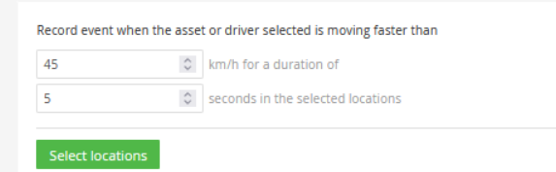
OVER SPEEDING IN LOCATION
This setting above on the event has the following logic:
Meaning you will need a series of positions in violation with a time difference between the first and last occurrence of at least 5 seconds. If not, we won’t raise out an event. If in between the series of position any dip under the speed, the rule resets and we start again.
Also – “series of positions” just means more than 1 consecutive positions that meets the criteria. The number in the series is irrelevant, we check if the duration between the first and last occurrence is greater than the period specified.

Slide 25
OVER SPEEDING IN LOCATION
Due to the logic of this event (explained on previous slide) it can lead to scenarios like the below question:
Why is the event not showing on Trip Timeline/reports when it has all the prerequisites and has triggered in Lightning?
The answer is this: The reason why these events do not go through to Data Warehouse is because they are not deemed as Significant events. For this to be deemed as such, there would need to be multiple positions that violate the speed threshold with at least 5 Seconds between the said positions and in the location. This is why they will only come through as Notification Events.

Slide 26
DISTANCE IN LOCATION
Rule – The distance in location is the sum of distance calculated on a straight line from the first position WITHIN the location to the last position WITHIN the location via all the positions in between PLUS the distance based on a straight line distance from location edge to first position and last position to location edge. See next slide for graphical explanation.
Typical Event Description – Distance in Location
Returned Value - Location Name & Distance and Duration.
NB note : Duration is calculated just like the distance including the edges of the location. If only one position, no duration will be available.
Events will not be visible on historical tracking, etc. until such time that the vehicle has exited the location

Slide 27
DISTANCE IN LOCATION
Blue line = road followed
Red line = distance displayed in system calculated in straight line
From Intersect with location between A to B +
Straight line from B to C +
From C to intersect with location between C to D
Duration is calculated the same way as distance.
Intersect between
C and D
Location A
A
D
Intersect between
A and B
B
C
NB : Distance and duration is always calculated in straight lines from entry to exit point
Because it uses passive data FM units will not have Live Tracking, Notifications or Info Hub for this event.
AVL’s = A,B,C,D

Slide 28
LOCATION ENTRY AND EXIT EVENT
Rule – The location entry and exit is calculated by using the first position within the location and the first position outside the location to calculate the duration. See next slide for graphical explanation.
If however no position was recorded within the location due to time between positions being to long, additional logic has been added to ensure movement within the location is detected. See slide 28 for explanation.
Typical Event Description – Location entry and exit
Returned Value - Location Name & max speed and other info like duration.
NB note : Duration will be calculated from the first position within the location and the first position outside the location where positions were recorded inside the location. If no positions were recorded within the location, but a location is detected in between the outlying positions via a straight line, then the duration will be from the first position outside the location on both sides. See slide 29

Slide 29
LOCATION ENTRY AND EXIT
Duration is the time between B and D
Available values are location name and max speed and duration
Distance not available
Duration
Location A
A
D
B
As with all server-side events if the location is small and the AVL frequency long, events can be missed. In this scenario additional logic has been added for this event as can be seen on next slide in cases where a possible intersect is detected
C
AVL’s = A,B,C,D

Slide 30
LOCATION ENTRY AND EXIT(no positions recorded inside location, but straight line between positions indicate possible intersection with a location)
Duration is the time between A and D
Available values are location name and max speed and duration
Distance not available
Duration
Location A
A
D
As with all server-side events if the location is small and the AVL frequency long, events can be missed. In this scenario additional logic has been added for this event as can be seen on this picture where a possible intersect is detected (yellow line)
AVL’s = A,D

Slide 31
HOW ARE SSE VIEWED IN DYNAMIX?
New event type: Server-side events
  Recorded events (Passive data only from the FM, All data from MiX2000/MiX4000/MiX6000)
    Event Report
    Historical Tracking (shows both passive and active position data, but only recorded /passive event data)
    Activity Timeline
  Active events (Active data only from the FM, All data from MiX2000/MiX4000/MiX6000)
    Live Tracking
    Info Hub
    Email/SMS Notifications can be created
***NB note : Excludes “Distance in location” and “Location entry and exit” as it calculates distance and duration based on passive positions only and therefore this event is not available in Live Tracking, Info Hub or in Notifications for FM’s.

Slide 32
Different types of SSE explained
Accumulated Events
Accumulated events have a start & stop, with duration &/or distance aka Detailed event. It is important to note that active messages are sent only at the beginning of an accumulated event and not for every position in the accumulated event. Therefore the max value on an active message could differ from the max value of the event.
Roadspeed Over Speeding
Over Speeding In Location
Distance In Location
Tiered Over Speeding
Location Entry And Exit
Non-Accumulated Events
Non-Accumulated events are like a notification event.
Location Entry
Location Exit
Movement Alert
Event at Location
Location Started
Location Stopped
Duration at location

Slide 33
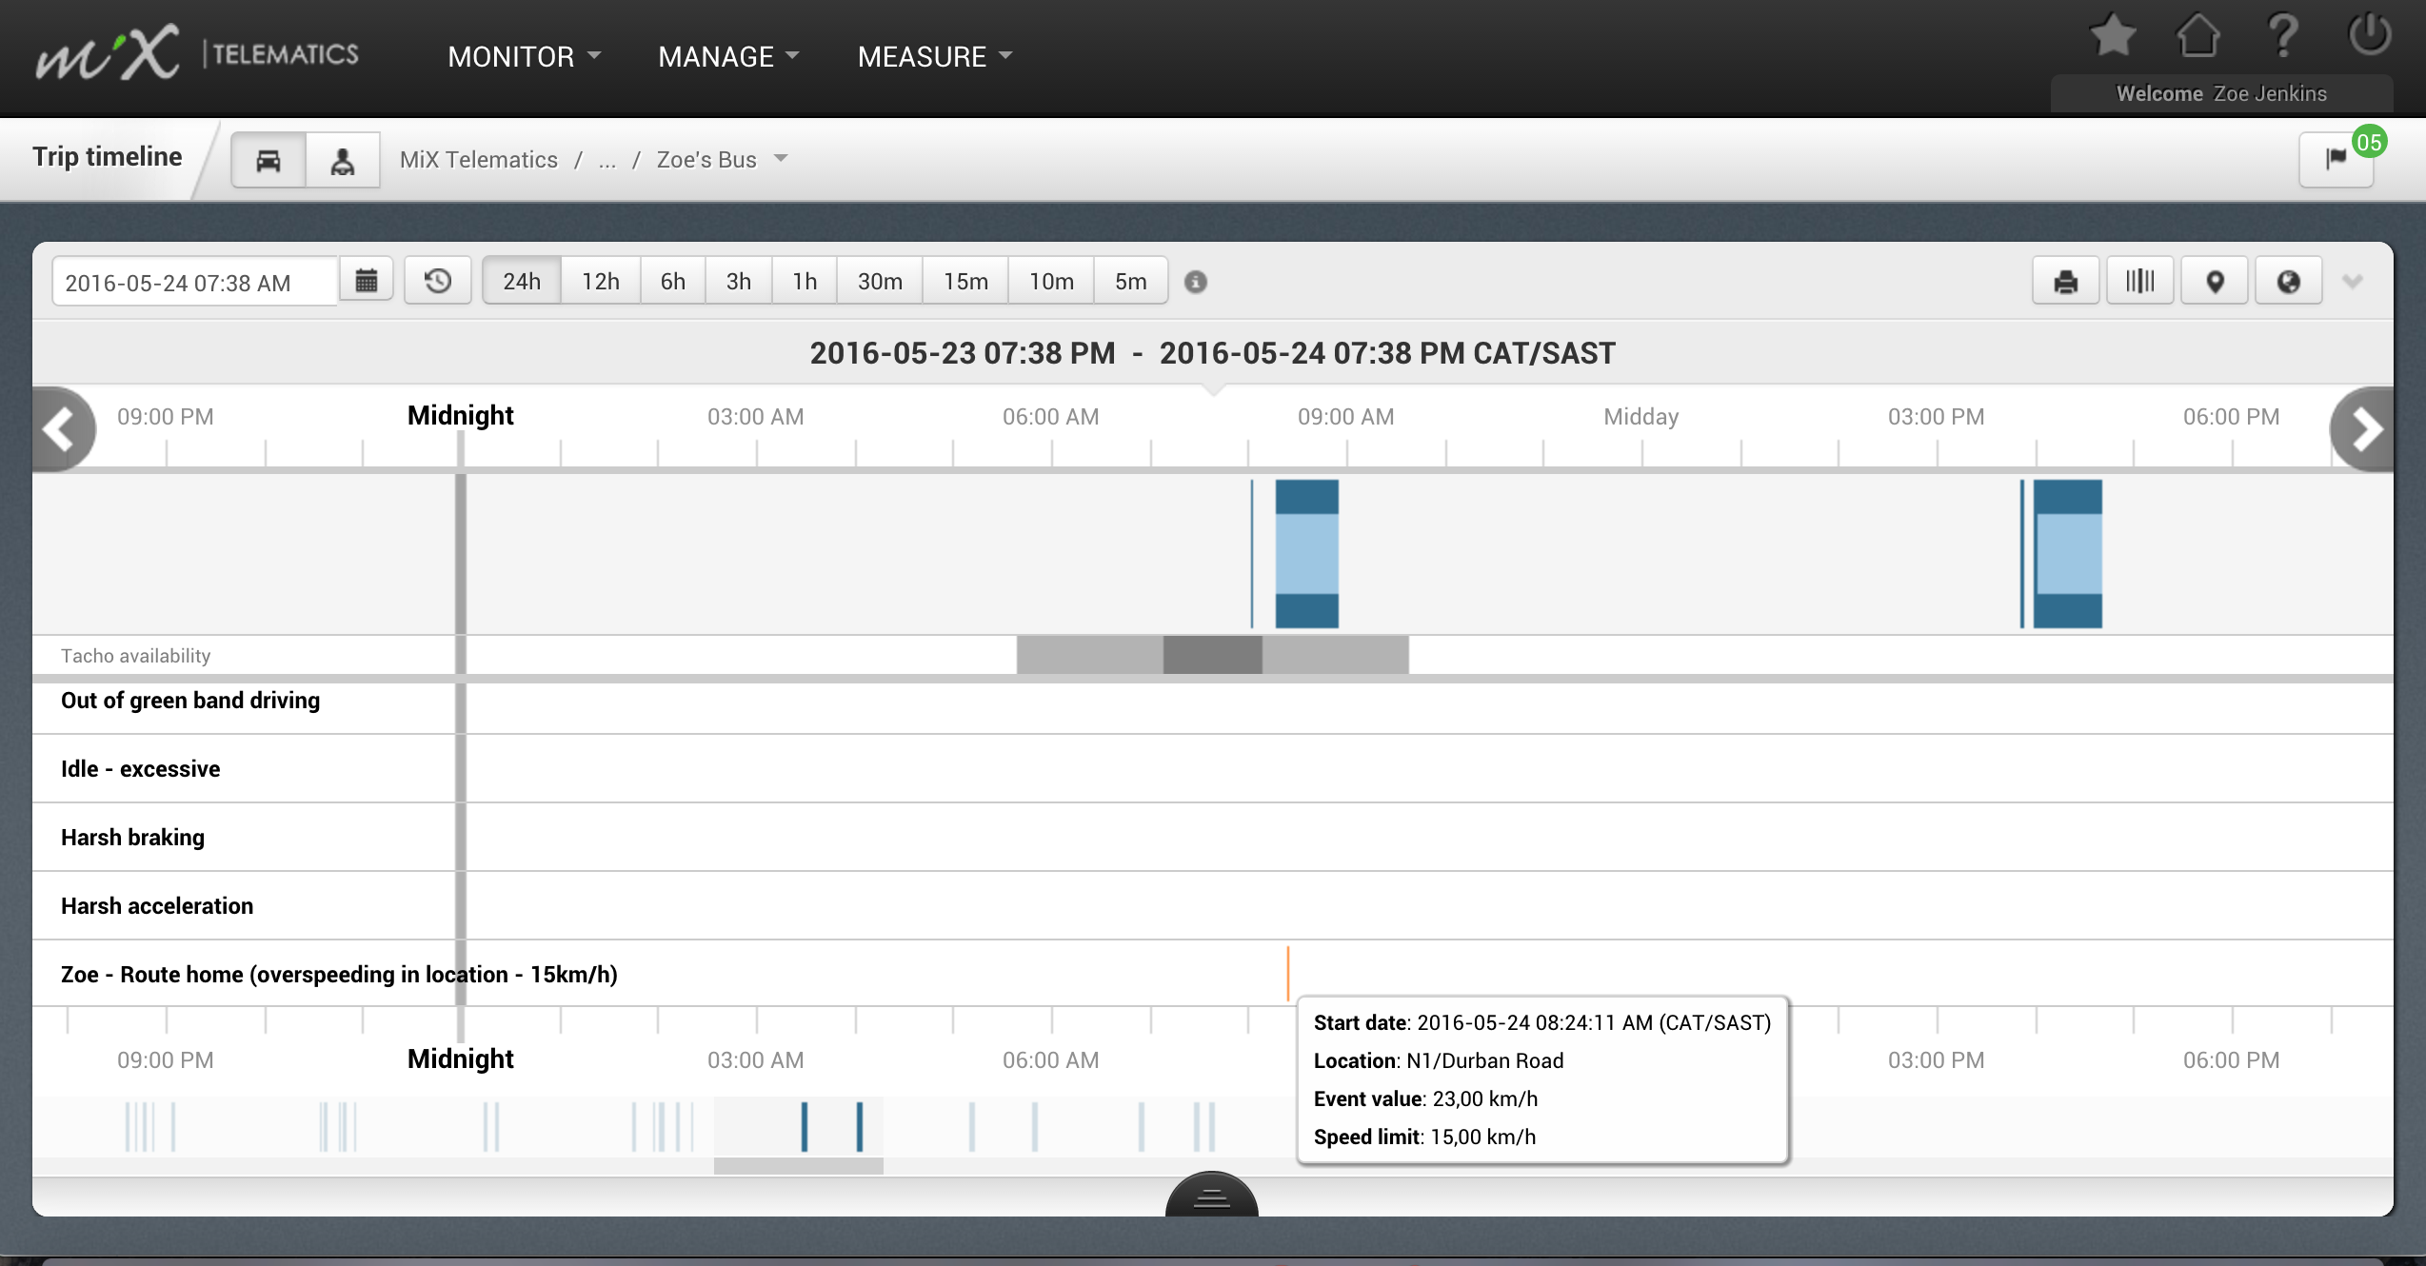
ACTIVITY TIMELINE

Slide 34
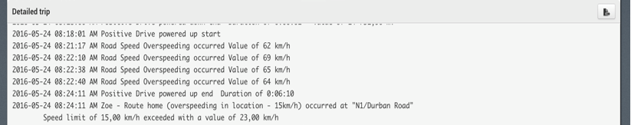
ACTIVITY TIMELINE
Information displayed in the Activity Timeline includes:
Date and time of the event
Location name
Speed Limit (Over-speeding in location event)
Maximum speed (Over-speeding in location event)

Slide 35
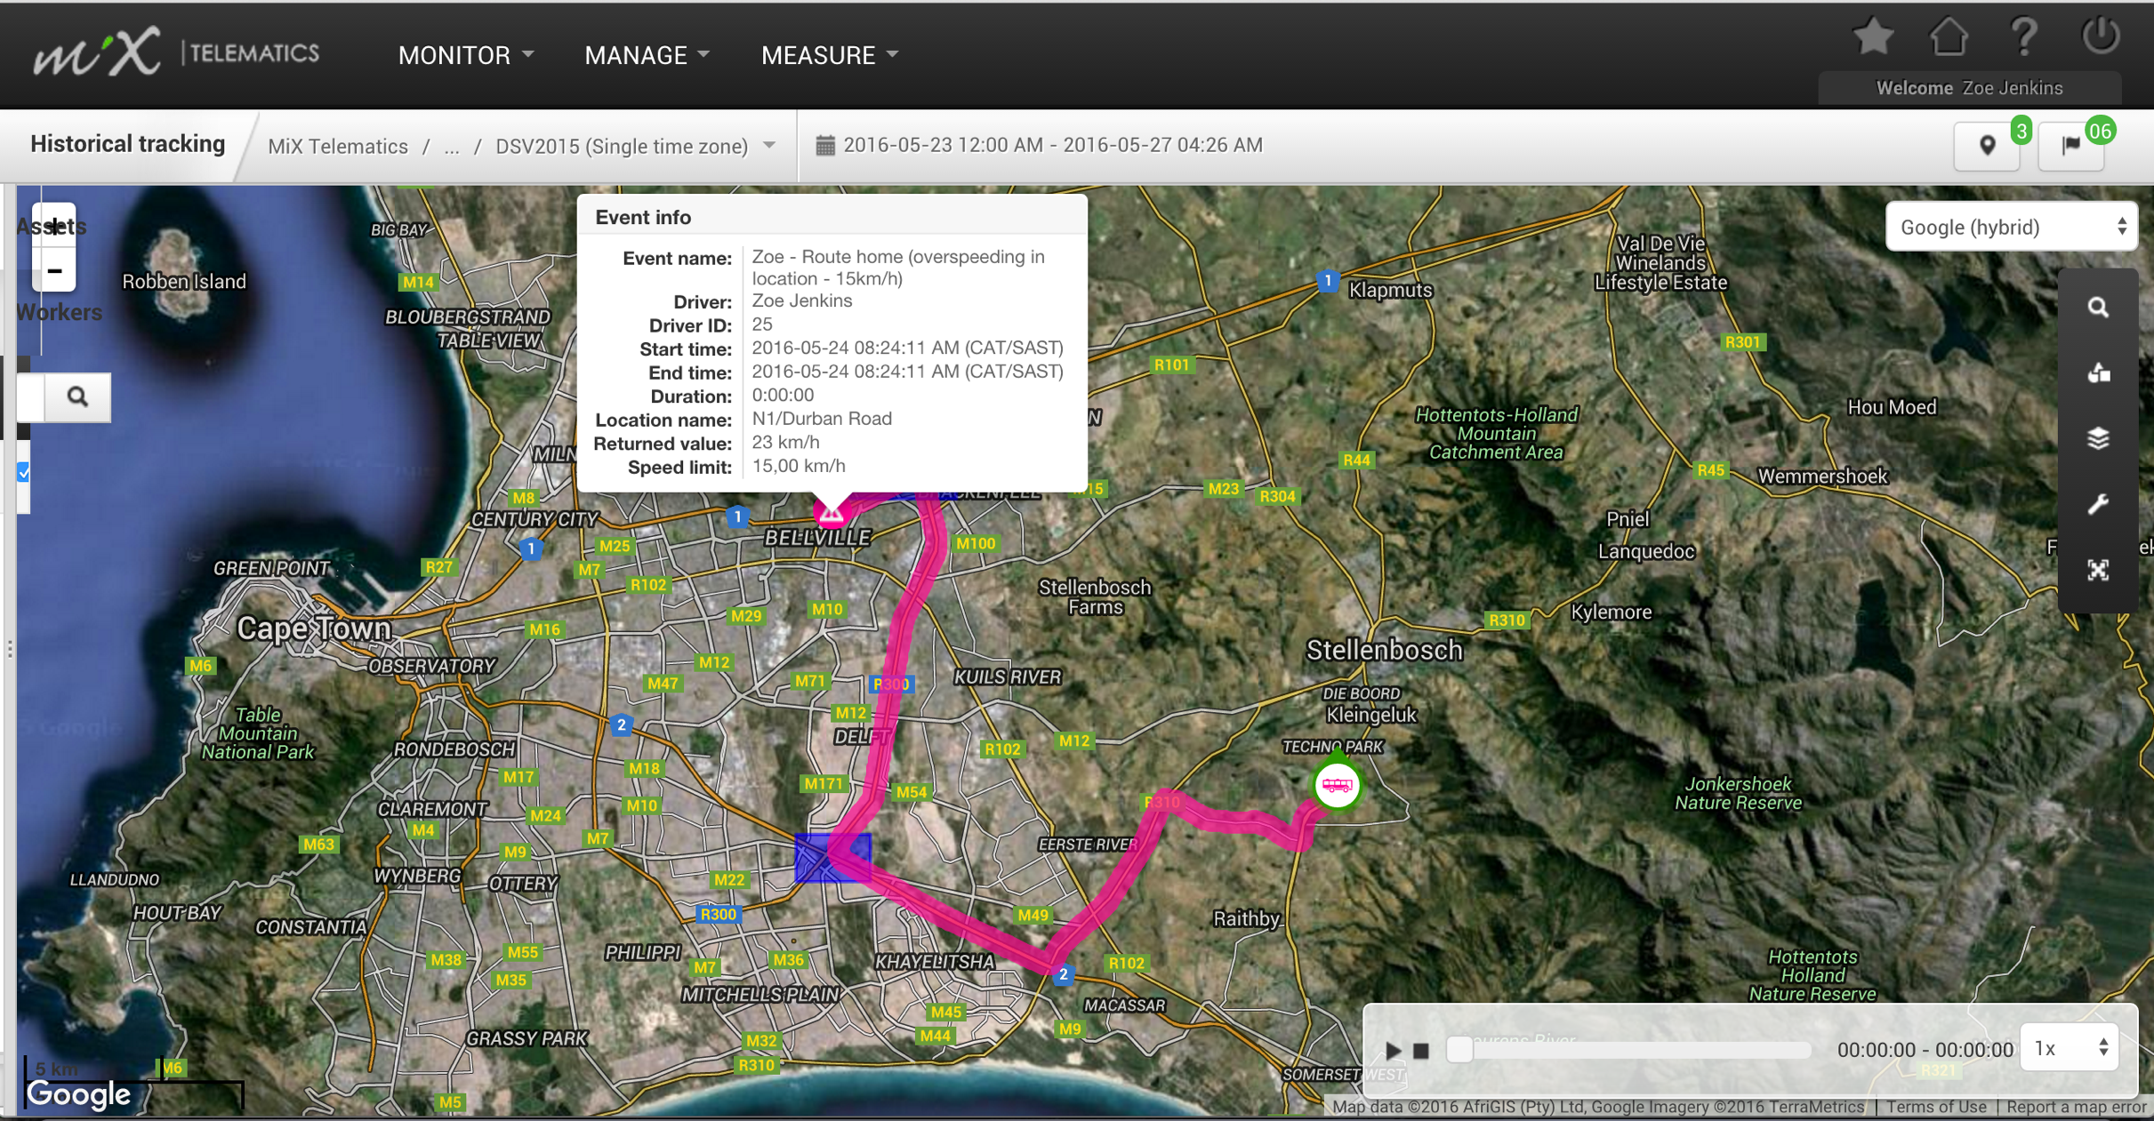
HISTORICAL TRACKING
Information displayed in Historical Tracking includes:
Date and time of the event
Location name
Speed Limit (Over- speeding in location event)
Maximum speed (Over- speeding in location event)
Duration (Over-speeding in location event)
On board event name (Event at location)

Slide 36
EVENT REPORT
Information displayed in the Detailed Event Report includes:
Date and time of the event
Event Location Name
Duration (Over-speeding in location event)
Maximum speed (Over-speeding in location event)
Event Value (Movement SSE)
Notes:
Location exit - select optional columns for Event Location and it should display the location name where the event occurred. It will not display duration and start and end time will display same time.
Location entry - select optional column for Event Location and it should display the location name where the event occurred. It will not display duration and start and end time will display same time.
Duration at location - select optional column for Event Location and it should display the location name where the event occurred, it will not display duration as the event is a notify type event and is set-up to only display the occurrence if the asset/driver were there for longer than "x" minutes. It will also display same start and end time.
Movement Alert - Select optional column for Measurement Units as this type of event will display the speed value in the default column "Event Value" and will display the measurement unit in the optional column. It will not display duration and start and end time will display same time. Will also not display the Event Location as that is not applicable to this type of event.
Over-speeding in location - Select optional columns for Event Location, Speed Limit and Measurement Units. All these columns should have values. This event will have different start and end times but no duration since it is a notify event type which do not display duration.
Location started - select optional columns for Event Location and it should display the location name where the event occurred. It will not display duration and start and end time will display same time.
Location stopped - select optional columns for Event Location and it should display the location name where the event occurred. It will not display duration and start and end time will display same time.
ALL SSE events are notify events. IE if you select the optional column "Event Type" all server side events will be Notify and they do not have durations.
Road Speed Events (This is for the default event only)
Select optional columns for Speed Limit, Measurement Units. This event will display different start and end time, event value, speed limit, duration, measurement unit type. It will not display event location.
Over speed in location (This is for default event only)
Select optional columns for Speed Limit, Event Location, Measurement Units. This event will display different start and end time, event value, speed limit, duration, measurement unit type and event location.

Slide 37
EVENT REPORT – which columns to select
Location exit - select optional columns for Event Location and it will display the location name where the event occurred. It will not display duration and start and end time will display same time.
Location entry - select optional column for Event Location and it will display the location name where the event occurred. It will not display duration and start and end time will display same time.
Duration at location - select optional column for Event Location and it will display the location name where the event occurred, it will not display duration as the event is a notify type event and is set-up to only display the occurrence if the asset/driver were there for longer than "x" minutes. It will also display same start and end time.
Distance in location – select optional column for Event Location and it will display the location name where the event occurred. Also select measurement units for the event value which will be the approximate distance. Start and End times will be different and Duration is also displayed.

Slide 38
EVENT REPORT – which columns to select
Movement Alert - Select optional column for Measurement Units as this type of event will display the speed value in the default column "Event Value" and will display the measurement unit in the optional column. It will not display duration and start and end time will display same time. Will also not display the Event Location as that is not applicable to this type of event.
Over-speeding in location - Select optional columns for Event Location, Speed Limit and Measurement Units. All these columns will have values. This event will have different start and end times as well as a duration.
Location started - select optional columns for Event Location and it will display the location name where the event occurred. It will not display duration and start and end time will display same time.
Location stopped - select optional columns for Event Location and it will display the location name where the event occurred. It will not display duration and start and end time will display same time.
Event at location – select optional columns for Event Location and it will display the location name where the event occurred. It will not display duration and start and end time will display same time.

Slide 39
EVENT REPORT – which columns to select
Location entry and exit– select optional columns for Event Location and it will display the location name where the event occurred. It will display duration and start and end time will be different.

Slide 40
EVENT REPORT – which columns to select
Road Speed Events (This is for the default event only) This event is not created like the other SSE events but it is also a SSE event.
Select optional columns for Speed Limit, Measurement Units. This event will display different start and end time, event value, speed limit, duration, measurement unit type. It will not display event location.
Over speed in location (This is for default event only) This is not a SSE event, just for info sake.
Select optional columns for Speed Limit, Event Location, Measurement Units. This event will display different start and end time, event value, speed limit, duration, measurement unit type and event location.

Slide 41
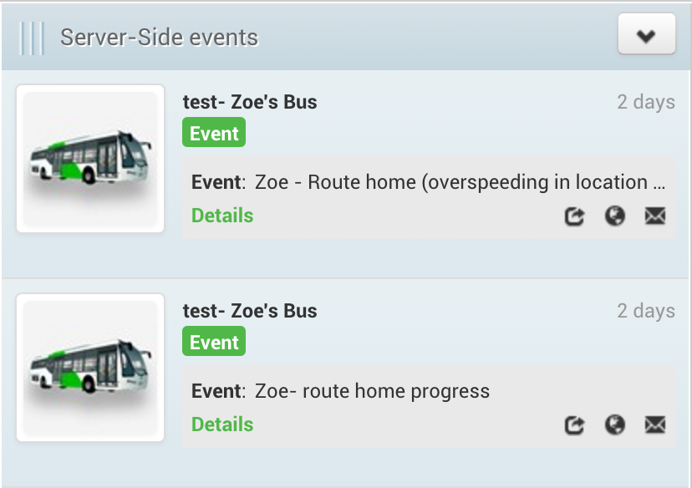
LIVE TRACKING & INFO HUB
Information displayed in Live Tracking and Info Hub includes:
Date and time of the event
Location name
Maximum speed

Slide 42
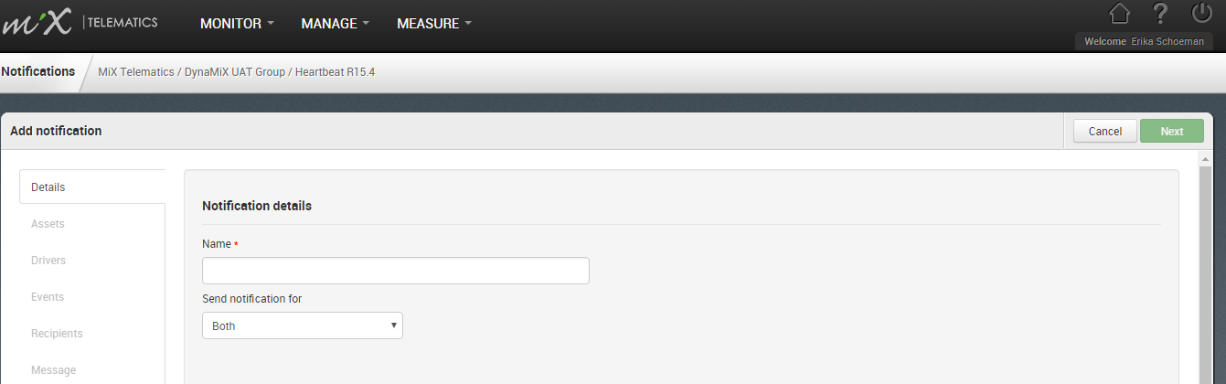
NOTIFICATIONS
Notifications can be set up using the new Notifications module in DynaMiX.
SMS and Email Notifications can be set up (Some environments do not support SMS, please consult with your RSO and remember SMS incurs cost).

Slide 43
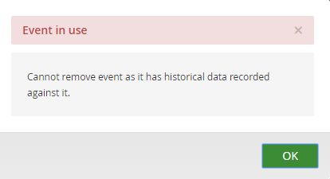
FAQ
How do I remove/delete a SSE?
When trying to remove an event and you see this message:
It means that because of historical info recorded the event
cannot be removed. In order to make it inactive you can
amend the expiry date which will move the event into the
Inactive state and it will no longer generate.

Slide 44
THANK YOU

